Slide 1

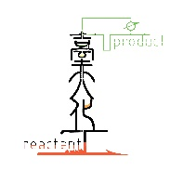
Python (II)
楊延齡
d00524018@ntu.edu.tw
09/07/2020

Slide 2

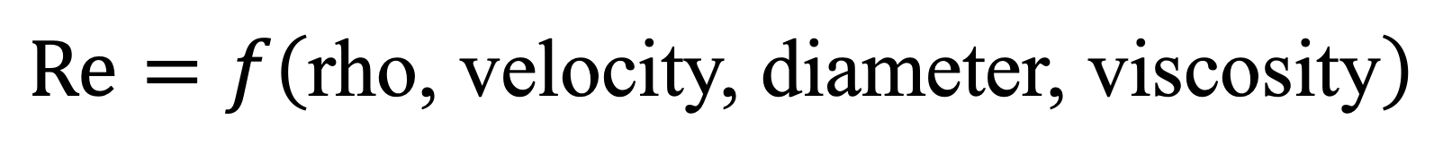
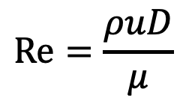
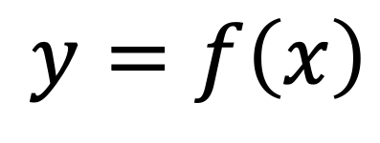
Function
1
$$y=f\left(x\right)$$
$$\text{Re}=\frac{ρuD}{μ}$$
$$\text{Re}=f\left(\text{rho}\text{,} \text{velocity}\text{,} \text{diameter}\text{,} \text{viscosity}\right)$$

Slide 3
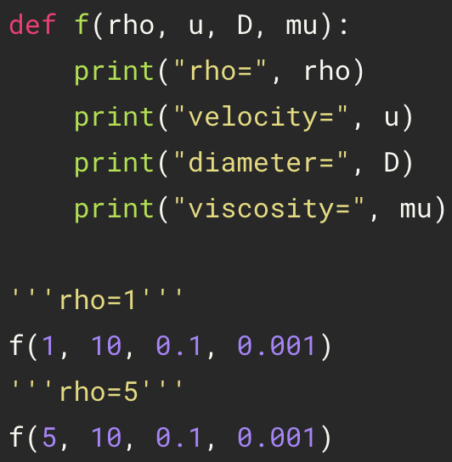
Defining and Calling Functions
2
space
colon
def name( parameters ) :
statements
name( arguments )
definition
Indent
call function
Parameter: Defined by the names that appear in a function definition
Argument: The values actually passed to a function when calling it
The arguments in calling function match that in defining function
The arguments can be integer, float, string, list, tuple, dict, numpy…

Slide 4
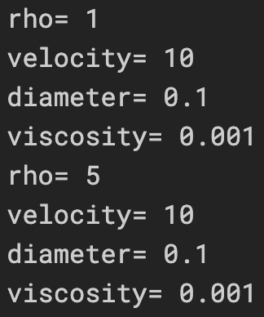
Defining and Calling Functions
3

Slide 5
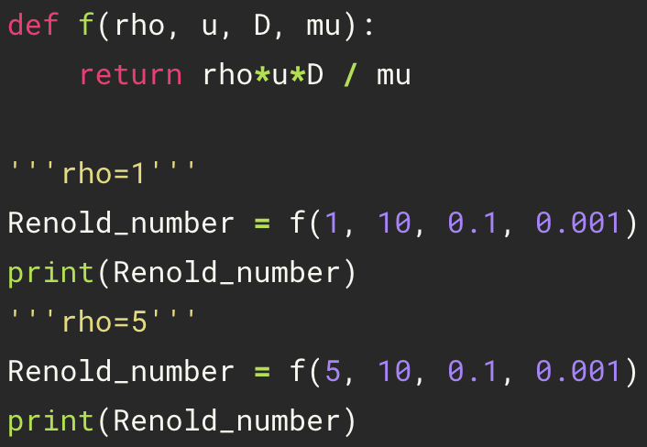
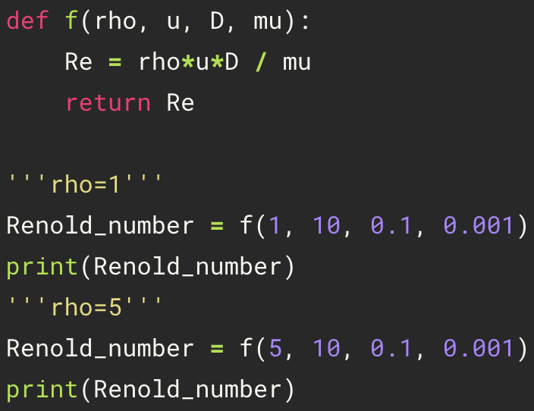
Return
4
space
colon
def name( parameters ) :
statements
return [expression]
variable = name( arguments )
Indent
The return type can be integer, float, string, list, tuple, dict, numpy…

Slide 6
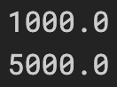
Defining and Calling Functions
5

Slide 7
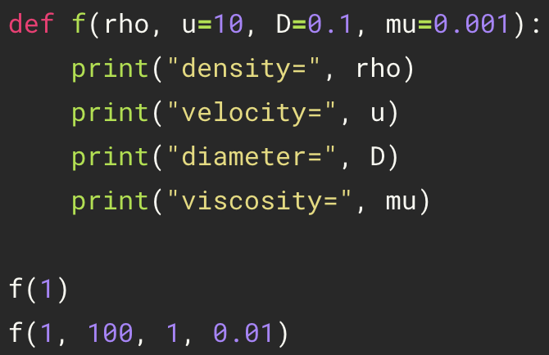
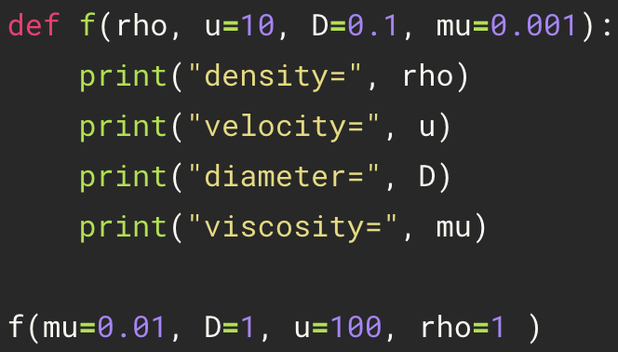
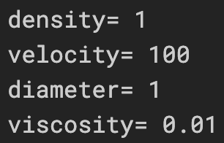
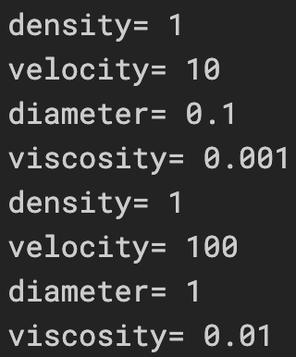
Argument
6
Default arguments
Keyword arguments
f(1)
The order of the arguments does not matter
f(1,100,1,0.01)

Slide 8
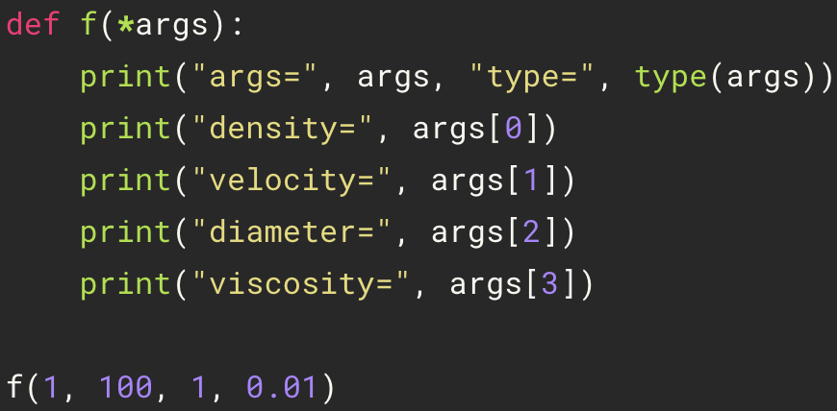
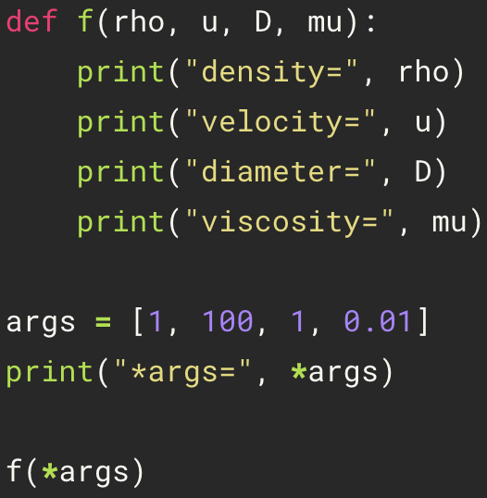
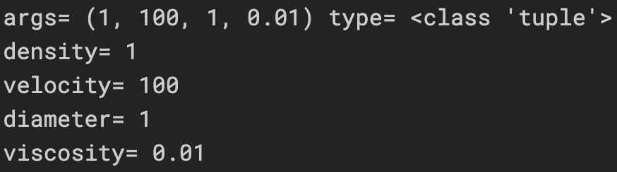
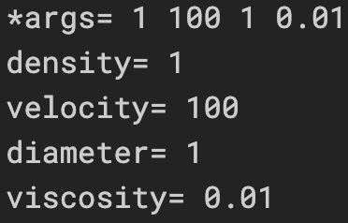
Packing or Unpacking into Arguments
7
Packing arguments
Unpacking arguments

Slide 9
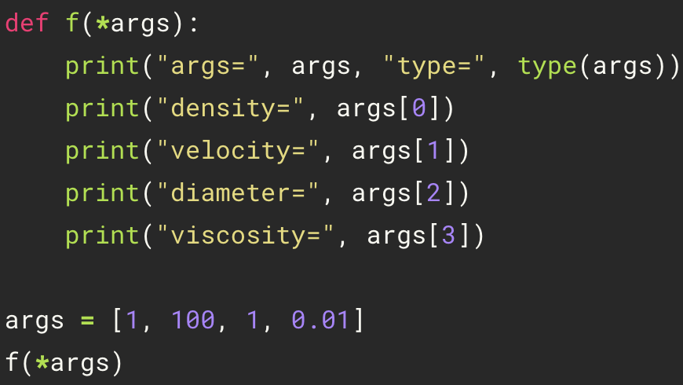
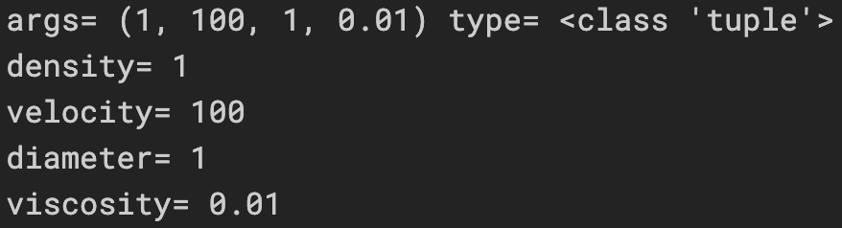
Packing and Unpacking into Arguments
8

Slide 10
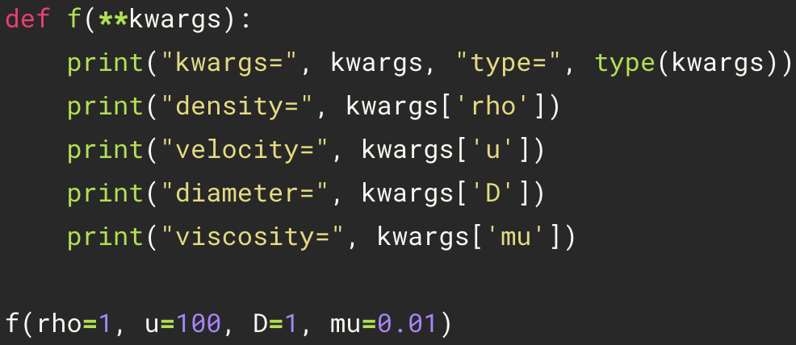
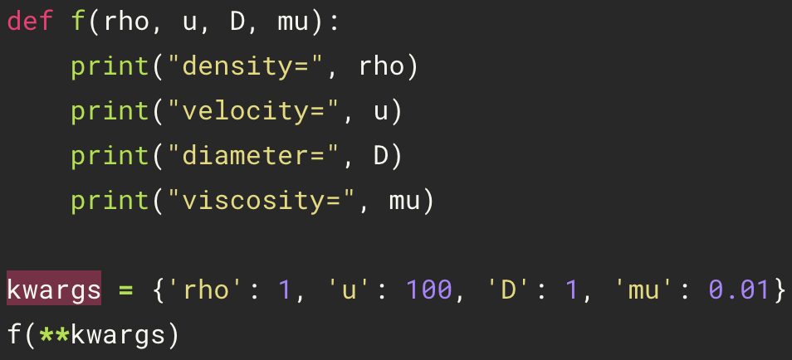
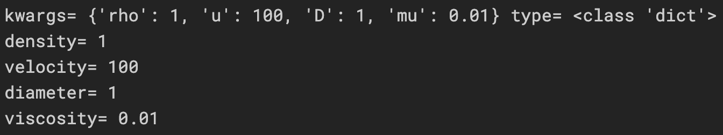
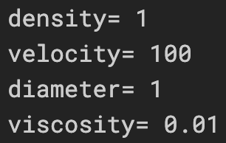
Packing or Unpacking Dict into kwargs
9
Packing kwargs
Unpacking kwargs
remain dict type!!!

Slide 11
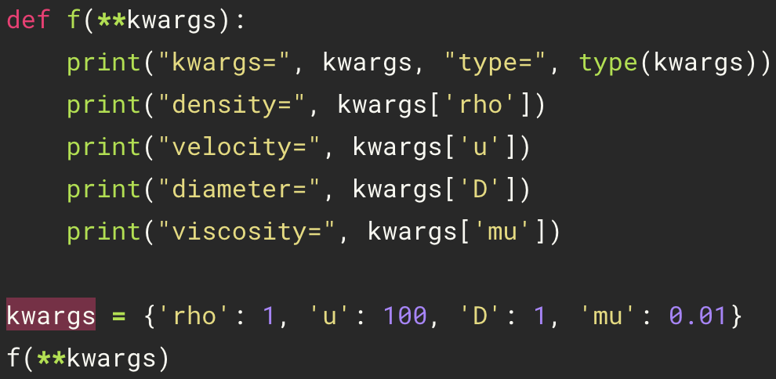
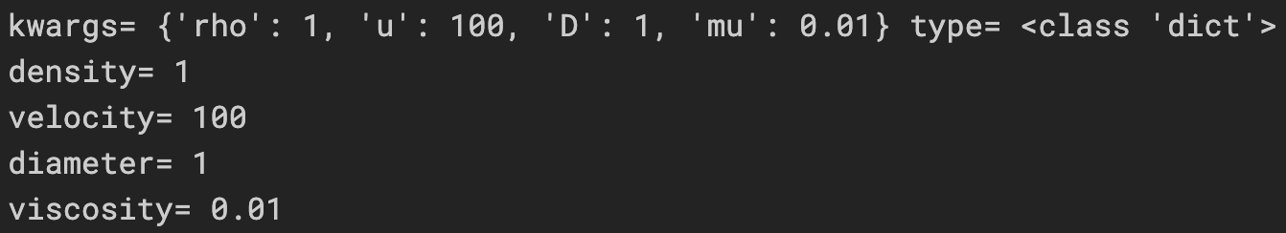
Packing and Unpacking Dict into kwargs
10

Slide 12
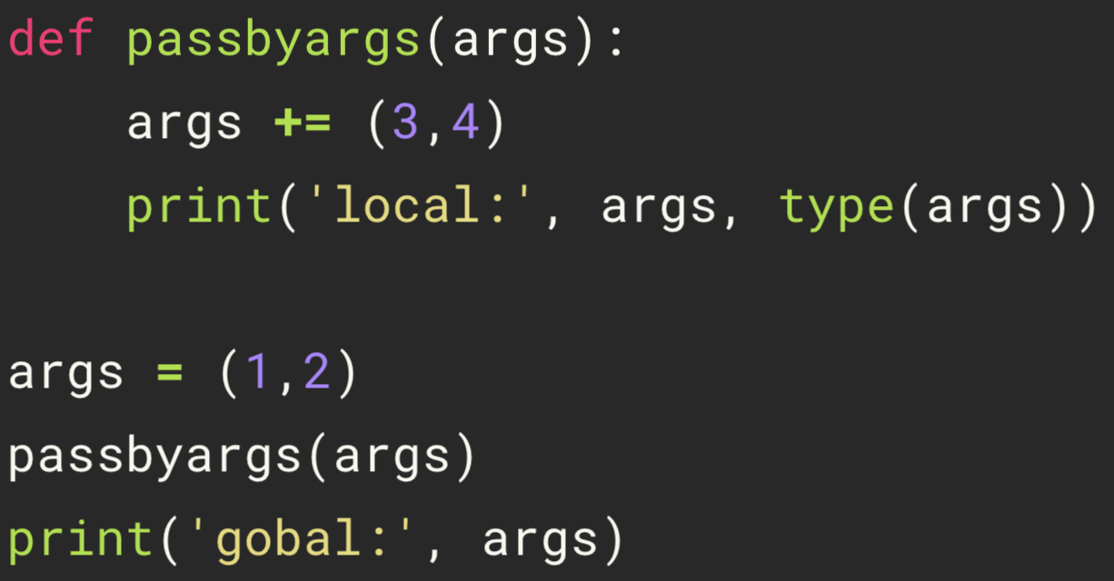
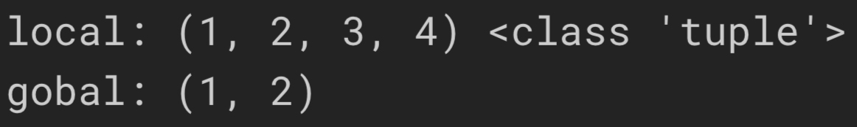
Pass by Tuple
11

Slide 13
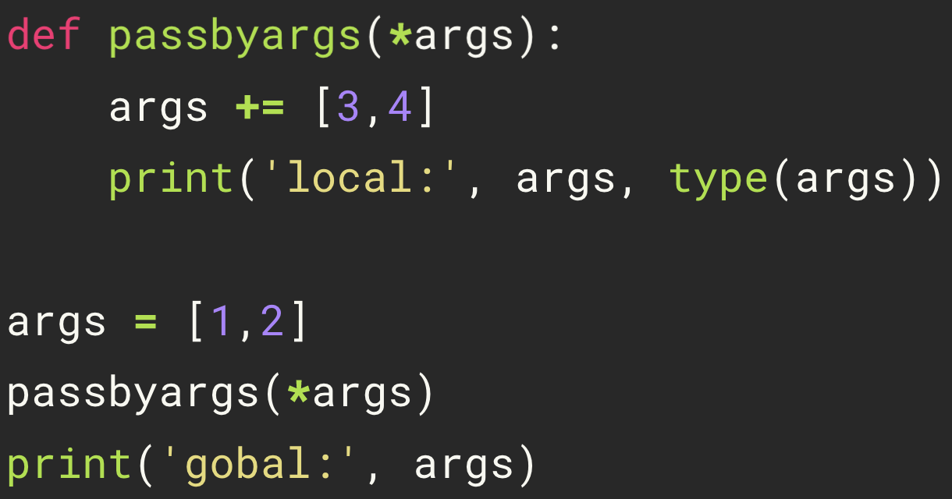
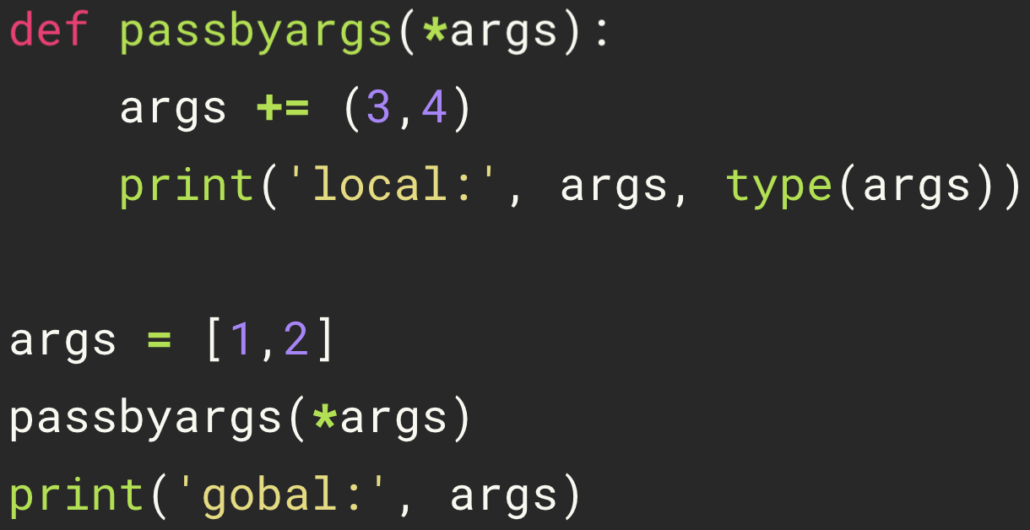
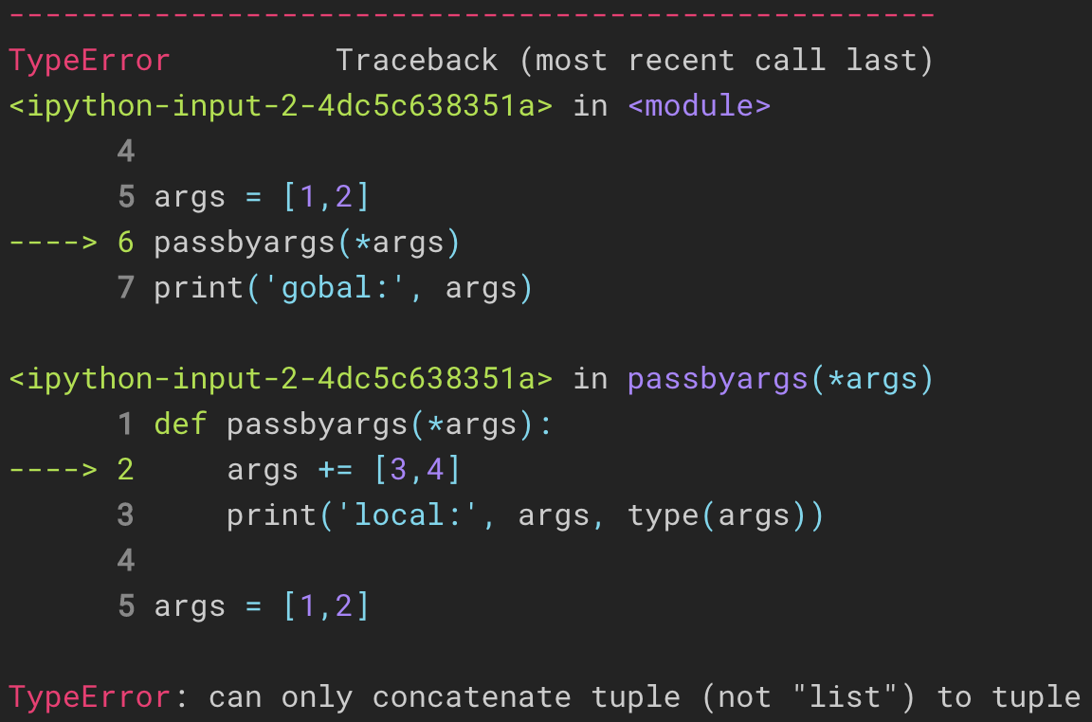
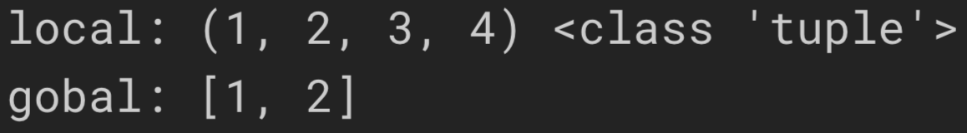
Pass by Unpacking Arguments
12

Slide 14
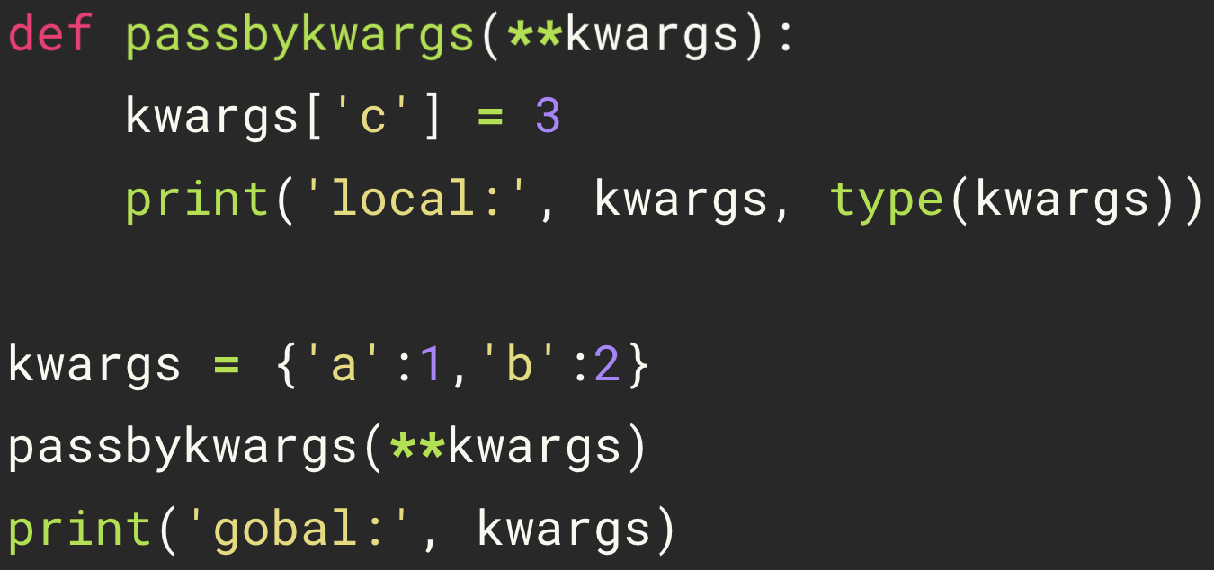
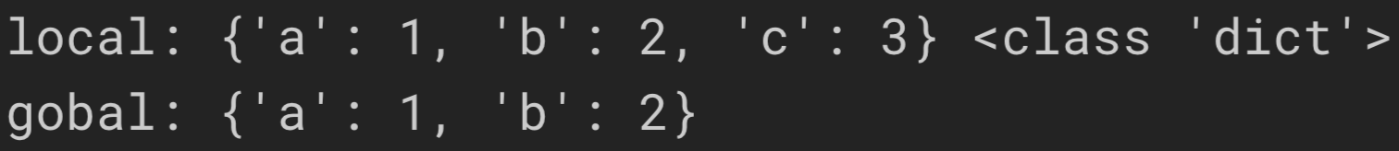
Pass by Unpacking Keyword Arguments
13

Slide 15
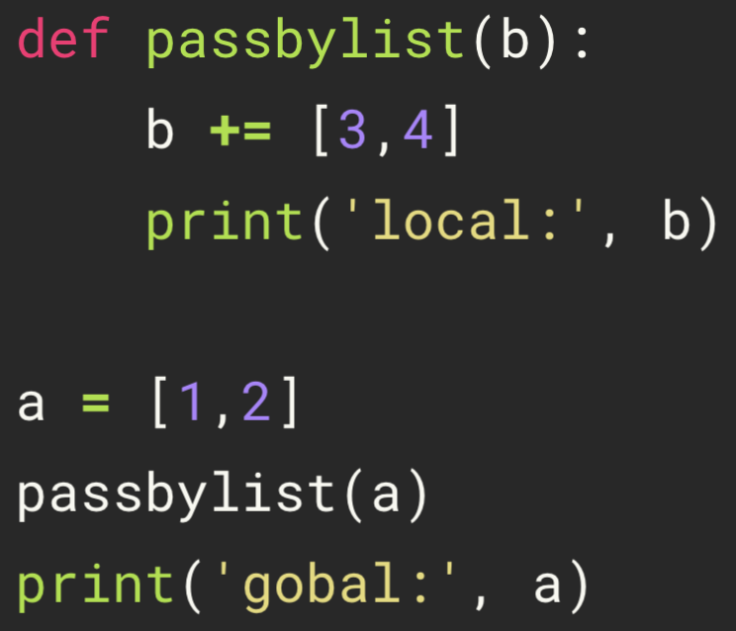
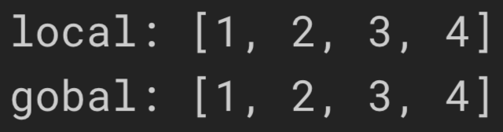
Pass by List
14

Slide 16
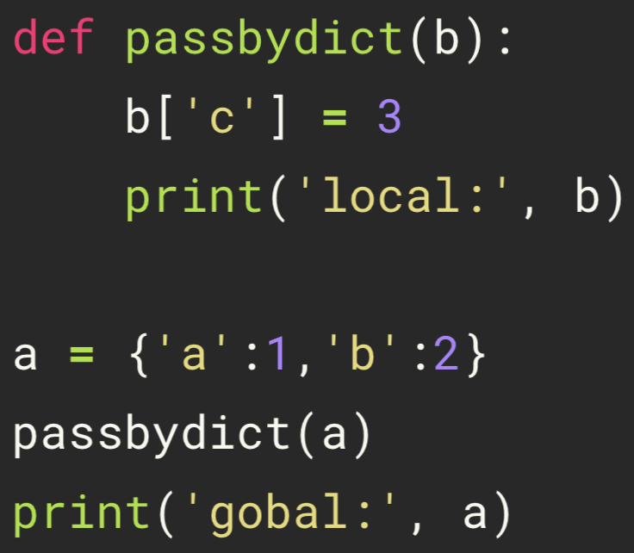
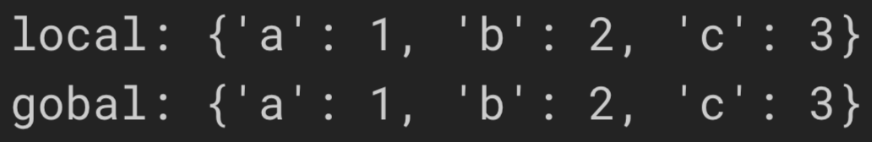
Pass by Dict
15

Slide 17
Practice
16
>>> def all_the_args(*args, **kwargs):
... print(args)
... print(kwargs)
>>> args = (1, 2, 3, 4)
>>> kwargs = {"a": 3, "b": 4}
>>> all_the_args(*args) # => (1, 2, 3, 4)
>>> all_the_args(**kwargs) # => (a=3, b=4)
>>> all_the_args(*args, **kwargs) # => (1, 2, 3, 4, a=3, b=4)
>>> def add(x, y):
... print("x is {} and y is {}".format(x, y))
... return x + y
>>> add(5, 6)
>>> add(y=6, x=5)
>>> def varargs(*args):
... return args
>>> varargs(1, 2, 3) # => (1, 2, 3)
>>> def swap(x, y):
... return y, x
>>> x = 1
>>> y = 2
>>> x, y = swap(x, y) # => x = 2, y = 1
>>> def create_adder(x):
... def adder(y):
... return x + y
... return adder
>>> add_10 = create_adder(10)
>>> add_10(3) # => 13
>>> def keyword_args(**kwargs):
... return kwargs
>>> keyword_args(big="foot", loch="ness")

Slide 18
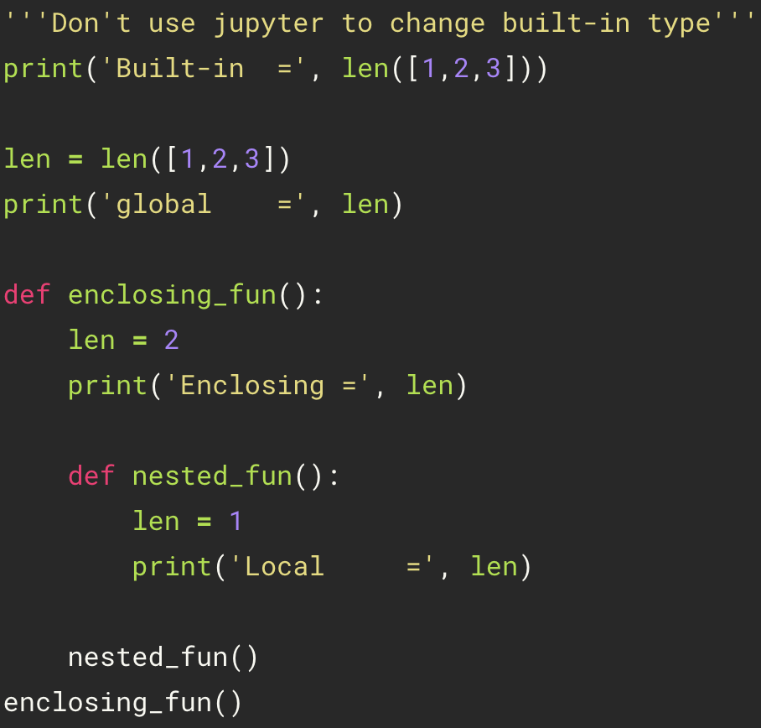
Python Scopes and Namespaces
17
Built-in
Global Scope
(or module)
Enclosing Scope
(or nonlocal)
Local Scope
(or function)

Slide 19
Local, Global, and Nonlocal Variables
18
Global variables: A variables declared outside of the function or
in the global scope
Local variables: Any variables declared inside the function or
in the local scope
Nonlocal variables: Used in nested functions whose local scope
is not defined

Slide 20
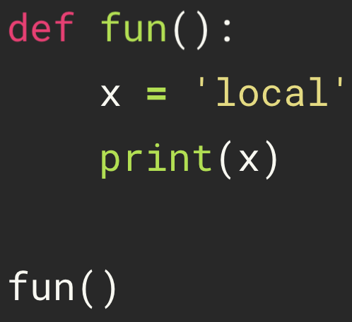
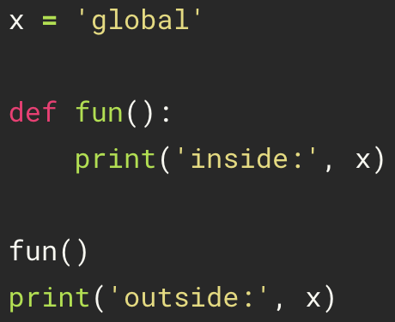
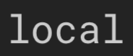
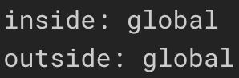
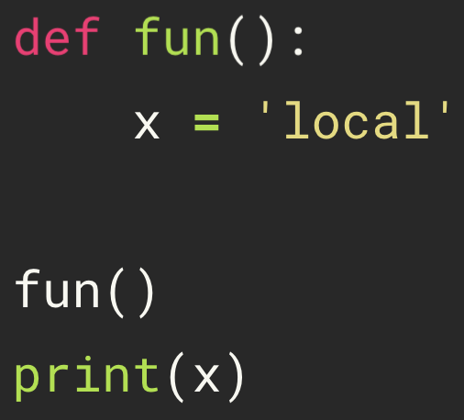
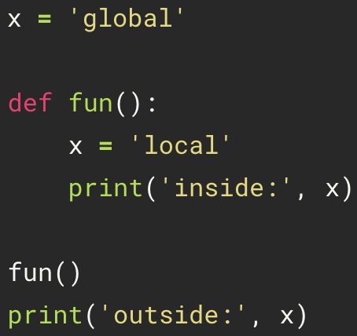
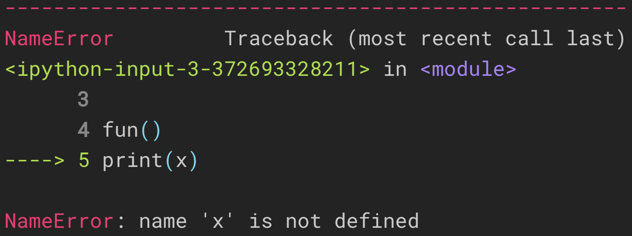
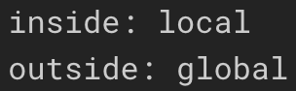
Local and Global Variables
19
Local
Global

Slide 21
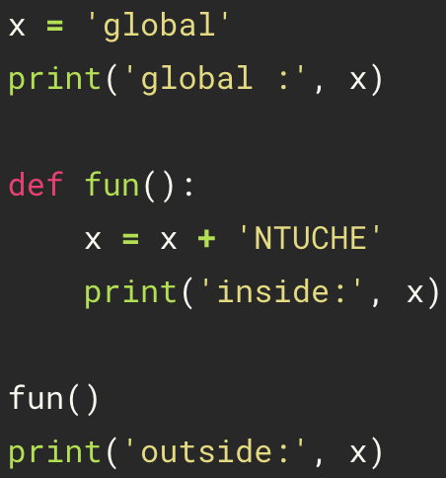
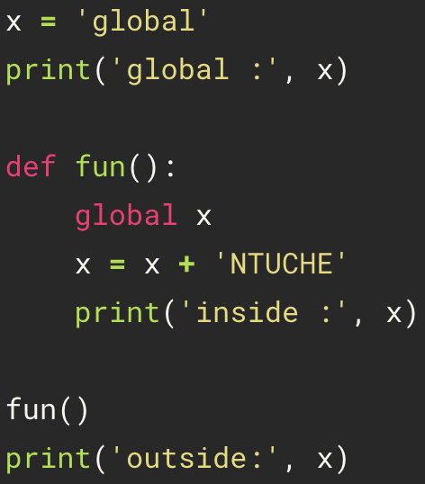
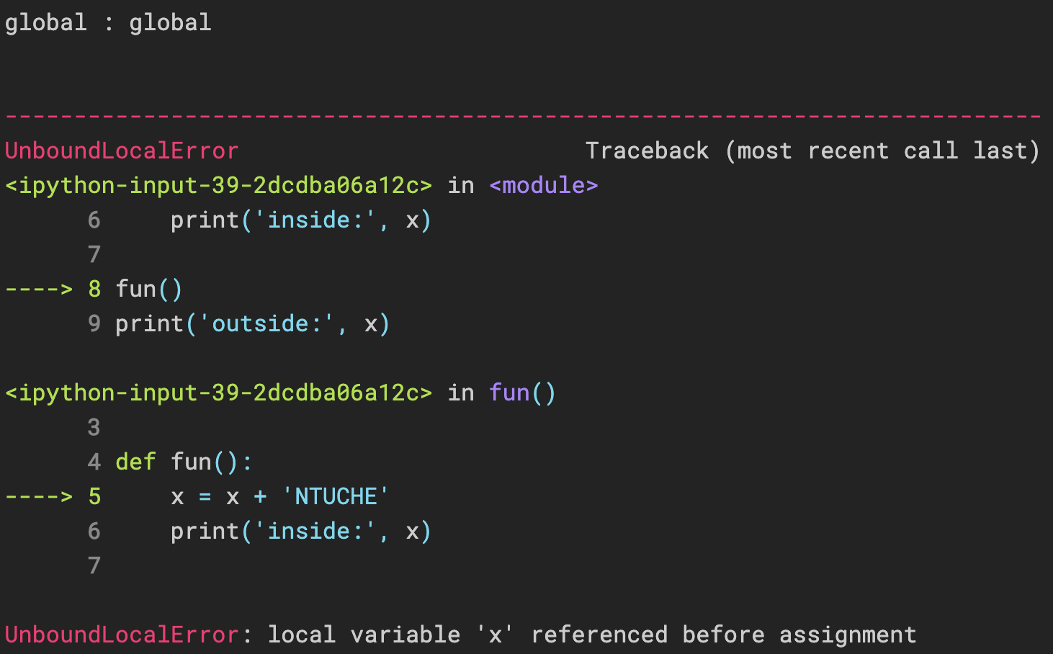
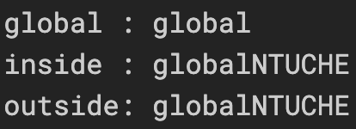
Global Variable
20

Slide 22


Nonlocal Variable
21

Slide 23


Practice
22

Slide 24




Practice
23

Slide 25
Python Scopes and Namespaces
24
>>> x = 'global'
>>> def a():
>>> print(x)
>>> def b():
>>> print(x)
>>> b()
>>> a()
x = ?
Nonlocal -> Global
# => x = 'global'
x = ?
Local -> Nonlocal -> Global
# => x = 'global'

Slide 26




Python Scopes and Namespaces
25

Slide 27




Python Scopes and Namespaces
26

Slide 28
Python Closure
27
>>> def a(x):
>>> y = x
>>> def b():
>>> print(y)
>>> b()
>>> a("NTU")
>>> def a(x):
>>> def b():
>>> print(x)
>>> b()
>>> a("NTU")

Slide 29



Python Closure
28

Slide 30

Python Closure
29
“NTU” is remembered even when the variable goes out of scope, or the function is removed from the namespace. If we delete outerfunc, myfunc still gives us “NTU” .

Slide 31
Lambda Expressions
30
>>> def identity(x):
... return x
>>> lambda x: x

Slide 32




Lambda Expressions
31
lambda arguments : expression

Slide 33

Input and Output
32
Syntax
open("filename", mode)
execute “pwd” command, which can show the path of the input/output file
Mode | Meaning
r | Opens a file for reading only. The file pointer is placed at the beginning of the file. This is the default mode.
w | Opens a file for writing only. Overwrites the file if the file exists. If the file does not exist, creates a new file for writing.
a | Opens a file for appending. The file pointer is at the end of the file if the file exists. That is, the file is in the append mode. If the file does not exist, it creates a new file for writing.

Slide 34






write
33
open("filename", "w")
writing
appending
overwriting

Slide 35



read
34
file.txt
*****I Love ***Shiang-Tai Lin*** very much*****
NTUCHE5566, NTUCHE183.
open("filename", "r")
\n: A newline

Slide 36





read(number)
35
file.txt
*****I Love ***Shiang-Tai Lin*** very much*****
NTUCHE5566, NTUCHE183.

Slide 37





readline(number)
36
file.txt
*****I Love ***Shiang-Tai Lin*** very much*****
NTUCHE5566, NTUCHE183.

Slide 38


Loop over the File Object
37
*****I Love ***Shiang-Tai Lin*** very much*****
NTUCHE5566, NTUCHE183.
a[0]
file.txt
a[1]

Slide 39


lstrip(), rstrip(), strip()
38
file.txt
*****I Love ***Shiang-Tai Lin*** very much*****
NTUCHE5566, NTUCHE183.

Slide 40


replace()
39
file.txt
*****I Love ***Shiang-Tai Lin*** very much*****
NTUCHE5566, NTUCHE183.

Slide 41


split()
40
file.txt
*****I Love ***Shiang-Tai Lin*** very much*****
NTUCHE5566, NTUCHE183.

Slide 42

Pandas
41
https://pandas.pydata.org/pandas-docs/stable/index.html

Slide 43



Pandas for different kinds of data
42
Tabular data with heterogeneously-typed columns, as in an SQL table or Excel spreadsheet
Arbitrary matrix data (homogeneously typed or heterogeneous) with row and column labels
Ordered and unordered (not necessarily fixed-frequency) time series data.

Slide 44

Pandas
43
Import
Object creation
>>> import pandas as pd
Dimension | Name | Description
1 | Series | 1D array-like object containing a sequence of values and an associated array of data labels, called its index
2 | DataFrame | General 2D labeled, size-mutable tabular structure with potentially heterogeneously-typed column

Slide 45

Series
44
List
>>> s1 = pd.Series([1, 3, 5, None, 6, 8])
>>> s1

Slide 46

Series
45
User-defined Index
Dictionary
>>> s2 = pd.Series([1, 3, 5, None, 6, 8],
index=['a', 'b', 'c', 'd', 'e', 'f'])
>>> s2
>>> sdata = {'a': 1, 'b': 3, 'c': 5, 'd': None, 'e': 6, 'f': 8}
>>> s3 = pd.Series(sdata)
>>> s3

Slide 47

DataFrame
46
List
Dictionary
>>> data1 = [['Bob', 1993, 173.5],
['Steve', 1996, 178.1],
['Jeff', 1994, 183.2]]
>>> df1 = pd.DataFrame(data1,
index=['I', 'II', 'III'],
columns=['student', 'birthyear', 'height'])
>>> df1
>>> data2 = {'student': ['Bob', 'Steve', 'Jeff'],
'birthyear': [1993, 1996, 1994],
'height': [173.5, 178.1, 183.2]}
>>> df2 = pd.DataFrame(data2,
index=['I', 'II', 'III'])
>>> df2

Slide 48
Read Data
47
csv
excel
>>> df1= pd.read_csv('logP_dataset.csv')
>>> df2 = pd.read_excel('LOL.xlsx')
csv | excel
text format | binary file
separated by commas | all the worksheets in a workbook
faster and also consumes less memory | slow and consumes more memory while importing data
Notes:
binary file and all the worksheets in a workbook (需要特定格式)

Slide 49




Viewing Data
48
>>> df2
>>> df2.head(3)
>>> df2.head()
>>> df2.tail(3)
5

Slide 50

Viewing Data
49
>>> df2
>>> df2.describe()

Slide 51


Viewing Data
50
>>> df2
>>> numpy_data = df2.values #to numpy
>>> df2.T #transpose

Slide 52

Getting
51
>>> df2
>>> df2['名稱']

Slide 53

Selection by Label
52
>>> df2
>>> df2.loc[2]

Slide 54
Selection by Position
53
>>> df2
>>> df2.iloc[2]

Slide 55


Selection by Position
54
>>> df2
>>> df2.iloc[2,0]
>>> df2.iloc[[1, 2, 4], [0, 2]]

Slide 56

Slice with Position
55
>>> df2
>>> df2.iloc[:,:3]

Slide 57

Boolean Indexing
56
>>> df2
>>> df = df2[df2['魔力提升'] > 0]
>>> df

Slide 58

Missing Data
57
>>> df2
>>> df = df2.drop(columns=['名稱', '類型'])
>>> df = df[df > 0]
>>> df

Slide 59

Missing Data
58
>>> df
>>> df = df2.drop(columns=['名稱', '類型'])
>>> df = df[df > 0]
>>> df = df.dropna(axis=0,how='any')
>>> df

Slide 60

Missing Data
59
>>> df
>>> df = df2.drop(columns=['名稱', '類型'])
>>> df = df[df > 0]
>>> df = df.dropna(axis=1,how='any')
>>> df

Slide 61

Missing Data
60
>>> df
>>> df = df2.drop(columns=['名稱', '類型'])
>>> df = df[df > 0]
>>> df = df.fillna(value=5)
>>> df

Slide 62


Statistic
61
>>> df2
>>> df2.sum()
>>> df2.sum(1)

Slide 63


Statistic
62
>>> df2
>>> df2.mean()
>>> df2.mean(1)

Slide 64

Apply
63
>>> df2
>>> df2['攻擊距離'] = df2['攻擊距離'].apply(lambda x: x/100)
>>> df2

Slide 65
Matplotlib
64
https://matplotlib.org/

Slide 66
pyplot.plot
65
>>> import matplotlib.pyplot as plt

Slide 67
plt.plot
66
Single data list
Two data lists
>>> plt.plot([1,2,3,4])
>>> plt.show()
>>> plt.plot([0.1, 0.2, 0.3, 0.4],
[1, 2, 3, 4])
>>> plt.show()

Slide 68
plt.plot
67
More Plots
>>> plt.plot([0.1, 0.2, 0.3, 0.4], [1, 2, 3, 4],
[0.1, 0.2, 0.3, 0.4], [1, 4, 9, 16])
>>> plt.show()
>>> plt.plot([0.1, 0.2, 0.3, 0.4], [1, 2, 3, 4])
>>> plt.plot([0.1, 0.2, 0.3, 0.4], [1, 4, 9, 16])
>>> plt.show()

Slide 69

plt.xlim and plt.ylim
68
>>> plt.plot([0.1, 0.2, 0.3, 0.4], [1, 2, 3, 4])
>>> plt.plot([0.1, 0.2, 0.3, 0.4], [1, 4, 9, 16])
>>> plt.xlim(0, 1)
>>> plt.ylim(-5, 20)
>>> plt.show()

Slide 70
title
69
>>> plt.title("Simple Plot")
>>> plt.plot([0.1, 0.2, 0.3, 0.4], [1, 2, 3, 4])
>>> plt.plot([0.1, 0.2, 0.3, 0.4], [1, 4, 9, 16])
>>> plt.show()

Slide 71
xlabel and ylabel
70
>>> plt.plot([0.1, 0.2, 0.3, 0.4], [1, 2, 3, 4])
>>> plt.plot([0.1, 0.2, 0.3, 0.4], [1, 4, 9, 16])
>>> plt.xlabel("Time (s)")
>>> plt.ylabel("Scale (Bananas)")
>>> plt.xlim(0, 1)
>>> plt.ylim(-5, 20)
>>> plt.show()

Slide 72
legend
71
>>> plt.plot([0.1, 0.2, 0.3, 0.4], [1, 2, 3, 4], label='Linear')
>>> plt.plot([0.1, 0.2, 0.3, 0.4], [1, 4, 9, 16], label='Square')
>>> plt.title("Simple Plot")
>>> plt.xlabel("Time (s)")
>>> plt.ylabel("Scale (Bananas)")
>>> plt.legend()
>>> plt.show()

Slide 73
Line
72
>>> plt.plot([0.1, 0.2, 0.3, 0.4], [1, 2, 3, 4], label='Linear', linestyle='-')
>>> plt.plot([0.1, 0.2, 0.3, 0.4], [1, 4, 9, 16], label='Square', linestyle='--')
>>> plt.plot([0.1, 0.2, 0.3, 0.4], [1, 8, 27, 64], label='Cube', linestyle='-.')
>>> plt.plot([0.1, 0.2, 0.3, 0.4], [1, 16, 81, 256], label='the fourth power', linestyle=':')
>>> plt.title("Simple Plot")
>>> plt.xlabel("Time (s)")
>>> plt.ylabel("Scale (Bananas)")
>>> plt.legend()
linestyle description
'-' or 'solid' solid line
'--' or 'dashed' dashed line
'-.' or 'dashdot' dash-dotted line
':' or 'dotted' dotted line

Slide 74
Color
73
>>> plt.plot([0.1, 0.2, 0.3, 0.4], [1, 2, 3, 4], label='Linear', linestyle='-', color='b')
>>> plt.plot([0.1, 0.2, 0.3, 0.4], [1, 4, 9, 16], label='Square', linestyle='--', color='g')
>>> plt.plot([0.1, 0.2, 0.3, 0.4], [1, 8, 27, 64], label='Cube', linestyle='-.', color='r')
>>> plt.plot([0.1, 0.2, 0.3, 0.4], [1, 16, 81, 256], label='the fourth power', linestyle=':', color='c')
>>> plt.title("Simple Plot")
>>> plt.xlabel("Time (s)")
>>> plt.ylabel("Scale (Bananas)")
>>> plt.legend()
>>> plt.show()
color description
'b' blue
'g' green
'r' red
'c' cyan
'm' magenta
'y' yellow
'k' black
'w' white

Slide 75
plt.scatter
74
Single data list
>>> x = [1,2,4,6,8,1,2,9,3]
>>> y = [5,7,2,3,1,4,6,5,8]
>>> plt.scatter(x, y)
>>> plt.show()

Slide 76
plt.scatter
75
Two data lists
>>> import random
>>> x1 = [17,6,15,17,5,18,18,15,11,19]
>>> x2 = [12,16,16,12,8,13,11,18,13,17]
>>> y1 = [46,58,45,50,53,49,56,32,49,33]
>>> y2 = [53,72,52,59,55,58,68,60,72,69]
>>> plt.scatter(x1, y1)
>>> plt.scatter(x2, y2)
>>> plt.show()

Slide 77
size
76
>>> plt.scatter(x1, y1, s=32)
>>> plt.scatter(x2, y2, s=128)
>>> plt.show()

Slide 78
title, xlabel and ylabel, legend
77
>>> plt.scatter(x1, y1, s=64, color='r', marker='^', label='group 1')
>>> plt.scatter(x2, y2, s=64, color='c', marker='s', label='group 2')
>>> plt.title("Simple Plot")
>>> plt.xlabel("Time (s)")
>>> plt.ylabel("Scale (Bananas)")
>>> plt.legend()
>>> plt.savefig('the_best_plot.pdf')
>>> plt.show()

Slide 79
Specification of Color and Shape
78
>>> plt.plot([0.1, 0.2, 0.3, 0.4], [1, 2, 3, 4], 'rx')
>>> plt.plot([0.1, 0.2, 0.3, 0.4], [1, 4, 9, 16], 'b-.')
>>> plt.xlabel("Time (s)")
>>> plt.ylabel("Scale (Bananas)")
>>> plt.show()

Slide 80

Markers
78
Link

Slide 81
plt.bar
79
>>> plt.bar(range(7), [1, 2, 3, 4, 3, 2, 1])
>>> plt.show()

Slide 82
Width (default=0.8)
80
>>> import numpy as np
>>> plt.bar(np.arange(0., 1.4, .2), [1, 2, 3, 4, 3, 2, 1])
>>> plt.show()

Slide 83
Width
81
>>> plt.bar(np.arange(0., 1.4, .2), [1, 2, 3, 4, 3, 2, 1], width=0.15)
>>> plt.show()

Slide 84
add_subplot
82
>>> x_data1 = [0.1, 0.2, 0.3, 0.4]
>>> y_data1 = [1, 2, 3, 4]
>>> x_data2 = [0.1, 0.2, 0.3, 0.4]
>>> y_data2 = [1, 4, 9, 16]
>>> fig = plt.figure()
>>> ax1 = fig.add_subplot(1, 2, 1)
>>> ax2 = fig.add_subplot(1, 2, 2)
>>> ax1.plot(x_data1, y_data1, label='data 1')
>>> ax2.plot(x_data2, y_data2, label='data 2')
>>> ax1.set_xlabel('Time (s)')
>>> ax1.set_ylabel('Scale (Bananas)')
>>> ax1.set_title('first data set')
>>> ax1.legend()
>>> ax2.set_xlabel('Time (s)')
>>> #ax2.set_ylabel('Scale (Bananas)')
>>> ax2.set_title('second data set')
>>> ax2.legend()
>>> plt.show()

Slide 85
Fitted a Function
83
>>> import matplotlib.pyplot as plt
>>> def found_fit(x):
>>> return 0.388 * x**2 # Found with symfit.
>>> x_data = list(range(10))
>>> y_data = [2, 3, 5, 7, 11, 13, 17, 19, 23, 29]
>>> x_func = np.linspace(0, 10, 50)
# numpy will do the right thing and evaluate found_fit for all elements
>>> y_func = found_fit(x_func)
>>> plt.scatter(x_data, y_data, c='r', label='data')
>>> plt.plot(x_func, y_func, label='$f(x) = 0.388 x^2$')
>>> plt.xlabel('x')
>>> plt.ylabel('y')
>>> plt.title('Fitting primes')
>>> plt.legend()
>>> plt.show()

Slide 86
plt.savefig
84
>>> plt.plot([0.1, 0.2, 0.3, 0.4], [1, 2, 3, 4], 'rx')
>>> plt.plot([0.1, 0.2, 0.3, 0.4], [1, 4, 9, 16], 'b-.')
>>> plt.xlabel("Time (s)")
>>> plt.ylabel("Scale (Bananas)")
>>> plt.savefig('the_best_plot.pdf')
>>> plt.show()

Slide 87



Others
85
>>> matplotlib.pyplot.hist
>>> matplotlib.pyplot.streamplot
>>> matplotlib.pyplot.pie

Slide 88
Plots
86

Slide 89

Find the Value of x that Makes Function Zero
87
$$f\left(x\right)=148.4−\frac{x^{2}}{{\left(1−x\right)}^{2}}$$
>>> from scipy.optimize import fsolve
>>> def equil_eq(x):
>>> return 148.4 - x*x/(1.0-x)**2
>>> x = fsolve(equil_eq, 0.5)
>>> print ('The root x is ', x)

Slide 90


Solve the Two Equations
88
$10x+3y^{2}=3$,
$$x^{2}−exp\left(y\right)=2$$
>>> from scipy.optimize import fsolve
>>> from scipy import exp
>>> import numpy as np
>>> def prob2(p):
>>> # vector components are transferred to the function
>>> x = p[0]
>>> y = p[1]
>>> return 10*x + 3*y*y -3, x*x - exp(y) - 2
>>> p = np.zeros(2,dtype=float)
>>> p[0] = 1.5
>>> p[1] = 2.5
>>> p = fsolve(prob2,p)
>>> print ('x =', p[0])
>>> print ('y =', p[1])
>>> x = p[0]
>>> y = p[1]
>>> print(10*x + 3*y*y -3)
>>> print(x*x - exp(y) - 2)

Slide 91

Solve Ordinary Differential Equations
89
$\frac{dy}{dx}=−10y$, $y\left(0\right)=1$
>>> from scipy.integrate import odeint
>>> import matplotlib.pyplot as plt
>>> import numpy as np
>>> def f(y, t):
>>> # this is the rhs of the ODE to integrate , i.e. dy/dt=f(y,t)
>>> return -10 * y
>>> y0 = 1 # initial value
>>> a = 0 # integration limits for t
>>> b = 1
>>> tspan = np.arange(a, b, 0.05) # values of t for which we require the solution y(t)
>>> y = odeint(f, y0 , tspan) # actual computation of y(t)
# plot the solution
>>> plt.plot(tspan, y)
>>> plt.xlabel('t')
>>> plt.ylabel('y(t)')
>>> plt.show()
# print the solution
>>> print(tspan, y)

Slide 92

Single Integrals
90
$$\int_{0}^{1}{xdx}$$
>>> import scipy.integrate
>>> def integrand(x):
>>> return x
>>> i = scipy.integrate.quad(integrand, 0, 1)
>>> print(i)

Slide 93

Fast Fourier Transform
91
$$X_{k}=\sum_{n=0}^{N−1}{x_{n}∙e^{{−i2πkn}/N}}$$
, $x_{n}$= np.sin(np.array((0., 30., 45., 60., 90.)) * np.pi / 180. )
>>> from scipy.fftpack import fft
>>> x = np.sin(np.array((0., 30., 45., 60., 90.)) * np.pi / 180. )
>>> y = fft(x)
>>> print(y)

Slide 94
Non-Linear Least Squares to Fit a Function
92
>>> import matplotlib.pyplot as plt
>>> from scipy.optimize import curve_fit
>>> def func(x, a, b, c):
>>> return a * np.exp(-b * x) + c
>>> xdata = np.linspace(0, 4, 50)
>>> y = func(xdata, 2.5, 1.3, 0.5)
>>> np.random.seed(1729)
>>> y_noise = 0.2 * np.random.normal(size=xdata.size)
>>> ydata = y + y_noise
>>> plt.plot(xdata, ydata, 'b-', label='data')
>>> popt, pcov = curve_fit(func, xdata, ydata)
>>> plt.plot(xdata, func(xdata, *popt), 'r-', label='fit: a=%5.3f, b=%5.3f, c=%5.3f' % tuple(popt))
>>> popt, pcov = curve_fit(func, xdata, ydata, bounds=(0, [3., 1., 0.5]))
>>> plt.plot(xdata, func(xdata, *popt), 'g--', label='fit: a=%5.3f, b=%5.3f, c=%5.3f' % tuple(popt))

Slide 95
Non-Linear Least Squares to Fit a Function
93
>>> plt.xlabel('x')
>>> plt.ylabel('y')
>>> plt.legend()
>>> plt.show()

